Slide 1
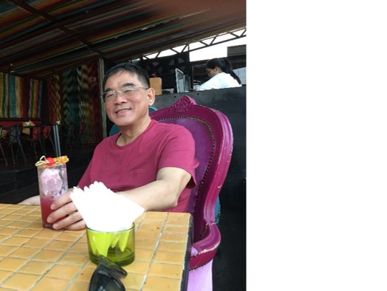
Database Addendum Lecture 1
Dr. Jefferson Fong

Slide 2
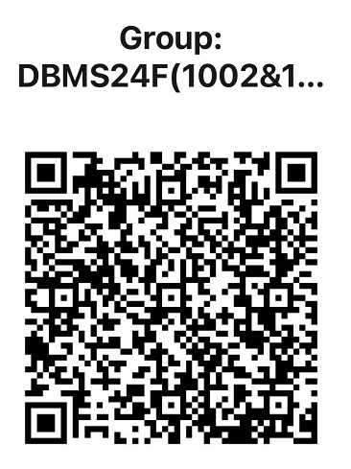
Class WeChat Group
Class WeChat group:
We will only answer questions that are addressed directly to us, e.g. @Jefferson
We will only answer during office hours or when we have time during the day
So don’t expect us to answer your questions immediately
Perhaps your classmates can answer the simple questions.
For personal questions, contact us by email or see us in person

Slide 3
General Comments in UIC
Most important things you learn in UIC is how to manage your time.
Time management is more important than database management or anything else we teach you in CST
You must decide how much time to spend on
Studying and doing homework
Activities
Sports, club activities, etc.
Social development
Hang out with friends, learn social skills
Playing with your cell phone or computer
Unlike high school, no one tells you when to study and play.
Your success in UIC, and life in general, depends on your choice.

Slide 4
Tentative Office Hours
T3-602-R1
Mon 1 – 5 pm
Tue 3 – 5 pm
Thu 2 – 2:50, 4 – 5 pm
Fri 3 – 5 pm
Plus by appointments
If possible, please let me know beforehand if you want to see me in my office hour.
Send me a message in class WeChat

Slide 5
Slide 2 Course Info
Textbook is in iSpace
Slide 3
Corrections: Lab meets on Thursdays, not Tuesdays.
Tutorial is optional
No new material will be presented
The TA can give further help on lab exercises, explanations on lectures, exercises solutions (after they are released), etc.
Time – TBD by TA, maybe immediately after lab?
If you cannot attend the tutorial for this section, you can attend the tutorial for another section.

Slide 6
Slide 4 Course assessment
CST Policy: There is a minimum score for the final exam.
A student scored below this minimum in the final exam will receive an F for the course, regardless of the student’s scores in other parts of the course.
The minimum final exam score ensures the student’s achievements are from the student’s own work and not copied from classmates.
Tentatively, the minimum final exam scores are
Final Exam Score | Highest Course Letter Grade
0 - 19 | F
20 – 24 | D
25 - 29 | C-

Slide 7
Slides 6 ff. Introduction to Database
Reference – Chapter 1 of textbook (7th edition)
See the Lecture Weekly Schedule (Slide 5), the column Readings
Slide 8 University DB Example
We will use this example throughout this course
Slide 9
Children ask Santa Clause for toys
Elves (Santa’s helpers) give
Nice children what they’ve asked
Naughty children a lump of coal
Note the data for Toys appear in two different places.

Slide 8
Slide 10-14
We will cover these points in detail later this semester.
Slide 15
Database Management System (DBMS) consists of
Database – data that are related
Software that manages the DB
DBAP = Database Application Program
Slide 16
UC Berkeley! Yeah!

Slide 9
Slide 18-20
Oracle is king
MySQL and PostgreSQL are free
MongoDB is open source, currently the biggest open source company
Relational DBMS database model is most used; focus of this course
From 2019 onward (Slide 19-20), multi-model becoming more important.
Need to access databases from different companies
More data are unstructured or loosely structured

Slide 10
Install XAMPP
Before next lab, try to install XAMPP in your computer.
In iSpace, see “For Students” > Labs > XAMPP Installation
We’ve done something similar in SWDW last semester.
Installation notes from SWDW are in “Section 1002/1005 Specific > Etc”, but the XAMPP Installation link should have enough info.
You can use XAMPP in the lab computers, but …
Advantages in using XAMPP in your own computer:
You can use it in your dorm.
Someone might mess up the settings and DB’s in the lab computers; they can’t mess up those in your own computer.

